Slide 1

Testing Session-1

Slide 2
Agenda
Basic Terminology of Testing
System Architecture
SDLC
SDLC Terminology
Types of SDLC

Slide 3
Basic Terminology of Testing
Project vs Product
Verification And validation
What Is Software Testing?
What is Testing?
Build /AUT
What is Test case
What is Company?
What is Client?

Slide 4
Basic Terminology of Testing
What is end User?
Error/mistake, Defect & Bug/Fault/Incident/Ticket/Change Request
Failure
Expected results
Actual results
Software Quality
Objectives of Testing

Slide 5
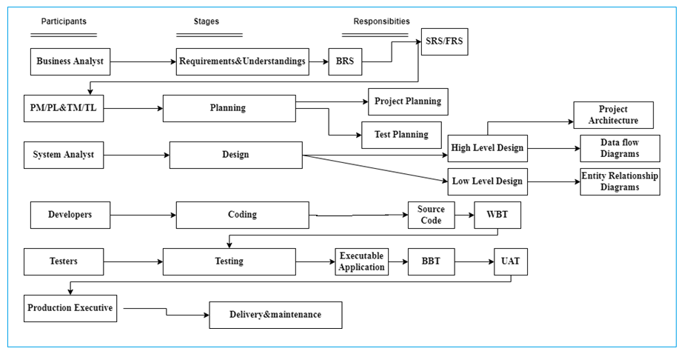
System Architecture

Slide 6
SDLC
Importance of SDLC
Terminology in SDLC
BRS
FRS/SRS
BD(Business Document)
DFD(Data Flow Diagrams)
WBT
BBT
UAT
AUT

Slide 7
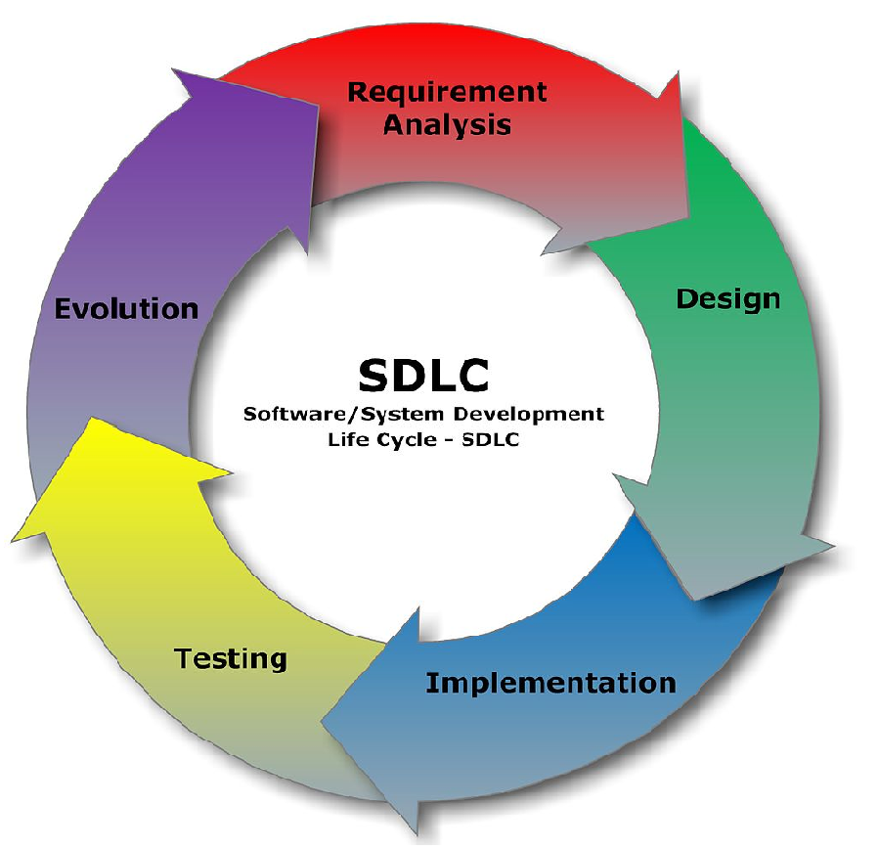
Sdl

Slide 8
Types of SDLC
Sequential model
Water fall model
V-V model
Incremental/Iterative model
Rapid Application Model(RAD)
Prototype model
Spiral model

Slide 9
Types of SDLC
Agile Model
Extreme Programming(XP)
DSDM(Dynamic System Development Method)
Kanban
Scrum
Crystal
FDD(Feature Driven Development)
Lean

Slide 10
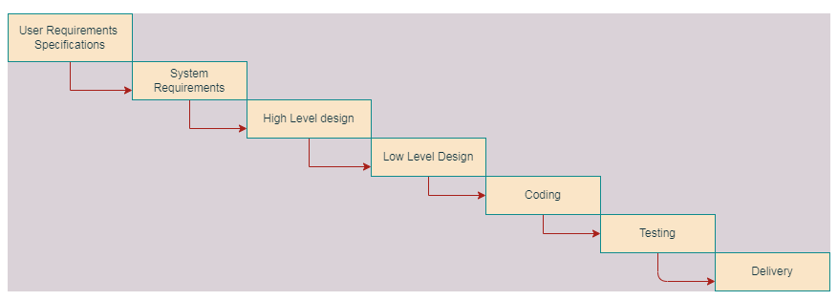
Water fall model Advantages and Dis-Advantages of water fall model

Slide 11
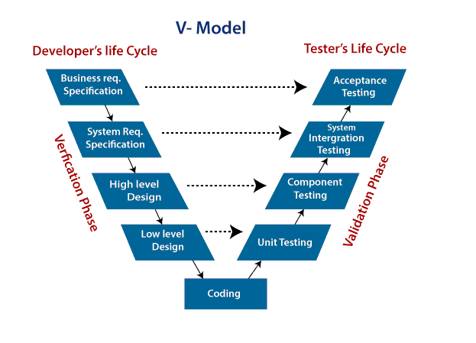
Advantages of V-Model
Dis-Advantages of V-Model

Slide 12
Why Swhizz?
Following the project-oriented training By working on user stories
Real time people will deliver the classes
Hands on experience.
One to One monitoring
Interaction sessions
Doubts Clarification Session
Expertise in resume preparation
Mock interviews
Job assistance
Associated with 50+ Clients
900+ students got placed

Slide 13
Any Queries?

Slide 14
Thank You
Mr.SubbaRao (Relationship Manager)
Contact:9059002244

